Slide 1
Hướng dẫn trình bày Poster
Kích thước poster:
A0 đứng - 1189 mm x 841 mm (46.8” x 33.1”)
Chữ trình bày trong poster
  Nên sử dụng những font thông dụng, rõ ràng, dễ nhìn
  Font size tối thiểu 24
Thiết kế đề mục trong poster
  Dựa trên những nội dung trong paper (Abstract, Introduction, Materials and Methods, Results and Discussion, Conclusion…)
  Linh hoạt trong việc bố trí các nội dung, chọn lựa màu sắc
  Ví dụ
  Slide 2 là 1 scientific poster template (A0 portrait) download từ internet. Ưu điểm là có sẵn bố cục và định dạng kích thước chuẩn A0
  Tùy đề tài và sự sáng tạo của mỗi người sẽ tạo ra sản phẩm của riêng mình (minh họa ở slide 3)
In ấn
  Poster hoàn chỉnh sẽ in màu 1 bảng A0 (để trưng bày)

Slide 2


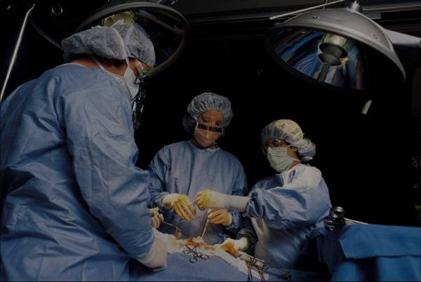
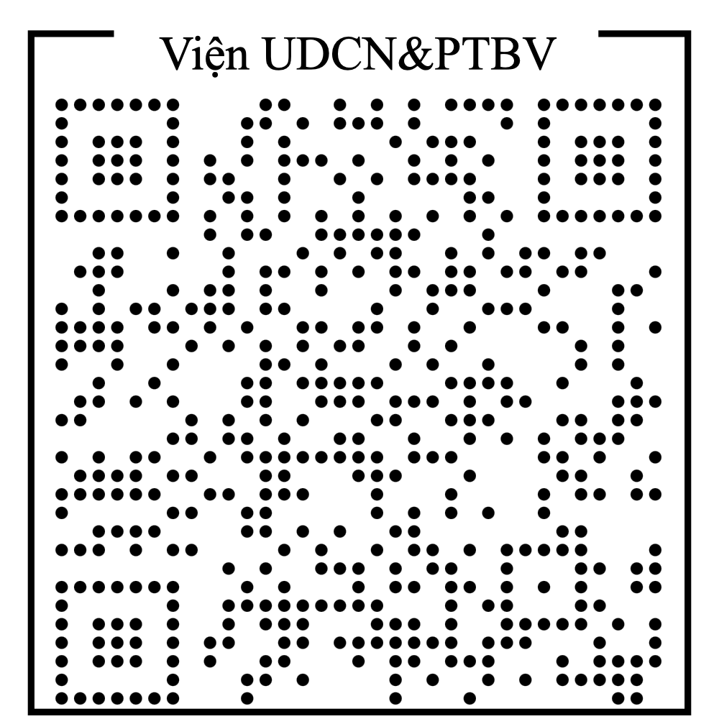
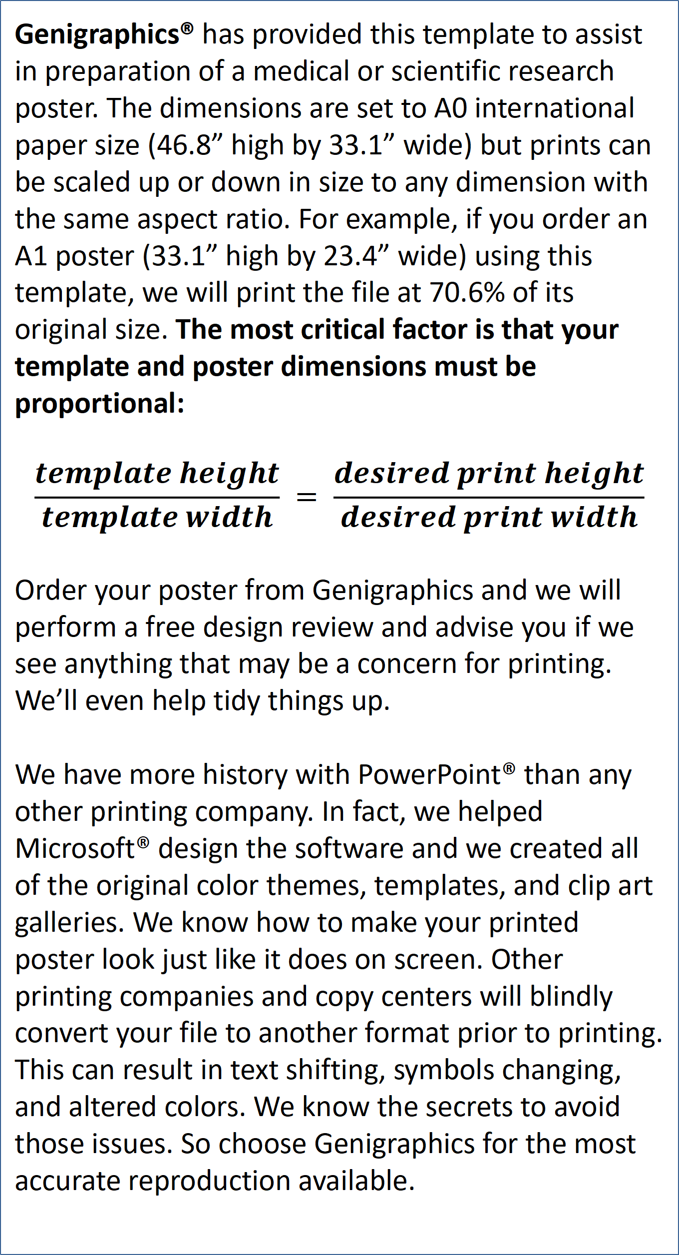
The 7th NTTU Student Research Workshop (NTTU-SRW): Chemistry - Food – Environment
Replace This Text With Your Title
John Smith, MD¹; Jane Doe, PhD²; Frederick Jones, MD, PhD^{1,2}
¹University of Affiliation, ²Medical Center of Affiliation
Abstract
Methods and Materials
Click here to insert your Abstract text. Type it in or copy and paste from your Word document or other source.
This text box will automatically re-size to your text. To turn off that feature, right click inside this box and go to Format Shape, Text Box, Autofit, and select the “Do Not Autofit” radio button.
To change the font style of this text box: Click on the border once to highlight the entire text box, then select a different font or font size that suits you. This text is Calibri 30pt and is easily read up to 4 feet away on an A0 poster.
Zoom out to 100% to preview what this will look like on your printed poster.
Click here to insert your Methods and Materials text. Type it in or copy and paste from your Word document or other source.
This text box will automatically re-size to your text. To turn off that feature, right click inside this box and go to Format Shape, Text Box, Autofit, and select the “Do Not Autofit” radio button.
To change the font style of this text box: Click on the border once to highlight the entire text box, then select a different font or font size that suits you. This text is Calibri 30pt and is easily read up to 4 feet away on an A0 poster.
Zoom out to 100% to preview what this will look like on your printed poster.
Chart 1. Label in 24pt Calibri.
Introduction
Results
Discussion
Genigraphics® has provided this template to assist in preparation of a medical or scientific research poster. The dimensions are set to A0 international paper size (46.8” high by 33.1” wide) but prints can be scaled up or down in size to any dimension with the same aspect ratio. For example, if you order an A1 poster (33.1” high by 23.4” wide) using this template, we will print the file at 70.6% of its original size. The most critical factor is that your template and poster dimensions must be proportional:
$$\frac{template height}{template width} = \frac{desired print height}{desired print width}$$
Order your poster from Genigraphics and we will perform a free design review and advise you if we see anything that may be a concern for printing. We’ll even help tidy things up.
We have more history with PowerPoint® than any other printing company. In fact, we helped Microsoft® design the software and we created all of the original color themes, templates, and clip art galleries. We know how to make your printed poster look just like it does on screen. Other printing companies and copy centers will blindly convert your file to another format prior to printing. This can result in text shifting, symbols changing, and altered colors. We know the secrets to avoid those issues. So choose Genigraphics for the most accurate reproduction available.
Click here to insert your Results text. Type it in or copy and paste from your Word document or other source.
This text box will automatically re-size to your text. To turn off that feature, right click inside this box and go to Format Shape, Text Box, Autofit, and select the “Do Not Autofit” radio button.
To change the font style of this text box: Click on the border once to highlight the entire text box, then select a different font or font size that suits you. This text is Calibri 30pt and is easily read up to 4 feet away on an A0 poster.
Zoom out to 100% to preview what this will look like on your printed poster.
Speaking of Results, yours will look better if you remember to run a spell-check on your poster! After you’ve added your content click on Review, Spelling, or press F7.
Click here to insert your Discussion text. Type it in or copy and paste from your Word document or other source.
This text box will automatically re-size to your text. To turn off that feature, right click inside this box and go to Format Shape, Text Box, Autofit, and select the “Do Not Autofit” radio button.
To change the font style of this text box: Click on the border once to highlight the entire text box, then select a different font or font size that suits you. This text is Calibri 30pt and is easily read up to 4 feet away on an A0 poster.
Zoom out to 100% to preview what this will look like on your printed poster.
Conclusions
Click here to insert your Conclusions text. Type it in or copy and paste from your Word document or other source.
This text box will automatically re-size to your text. To turn off that feature, right click inside this box and go to Format Shape, Text Box, Autofit, and select the “Do Not Autofit” radio button.
To change the font style of this text box: Click on the border once to highlight the entire text box, then select a different font or font size that suits you. This text is Calibri 30pt and is easily read up to 4 feet away on an A0 poster.
Zoom out to 100% to preview what this will look like on your printed poster.
Table 1. Label in 24pt Calibri.
 | Heading | Heading | Heading
Item | 800 | 790 | 4001
Item | 356 | 856 | 290
Item | 228 | 134 | 238
Item | 954 | 875 | 976
Item | 324 | 325 | 301
Item | 199 | 137 | 186
Figure 1. Label in 24pt Calibri.
Figure 2. Label in 24pt Calibri.
Contact
References
<your name>
Institute of Applied Technology and Sustainable Development
Nguyen Tat Thanh University, Ho Chi Minh City, Vietnam
Website: https://kttpmt.ntt.edu.vn/
Phone: (+84) 19002039 - ext. 409
Email:
Cell phone:

